Slide 1
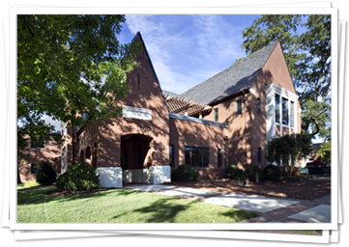

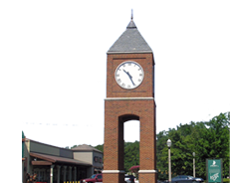

Alabama City/County Management Association
Winter Conference, January 24-26; Mountain Brook, Alabama
ICMA Update | January 2018

Slide 2
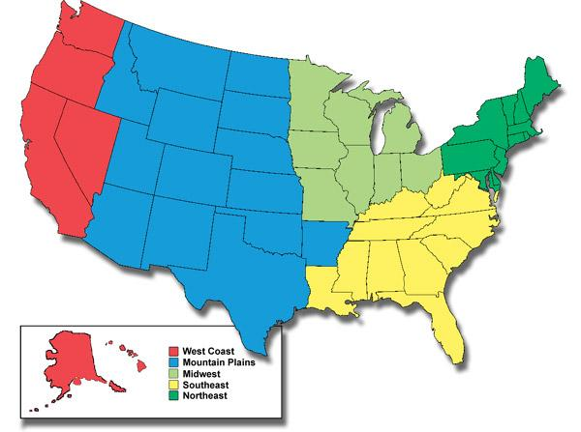
SOUTHEAST REGION

Slide 3
SOUTHEAST ICMA LEADERSHIP
Carl Harness
  Florida, Georgia, Louisiana, West Virginia
Ed Driggers
  South Carolina, Kentucky, Mississippi, Tennessee
Lane Bailey
  Alabama, North Carolina, Virginia
  ____________________________________
Randy Reid
ICMA Southeast Regional Director

Slide 4
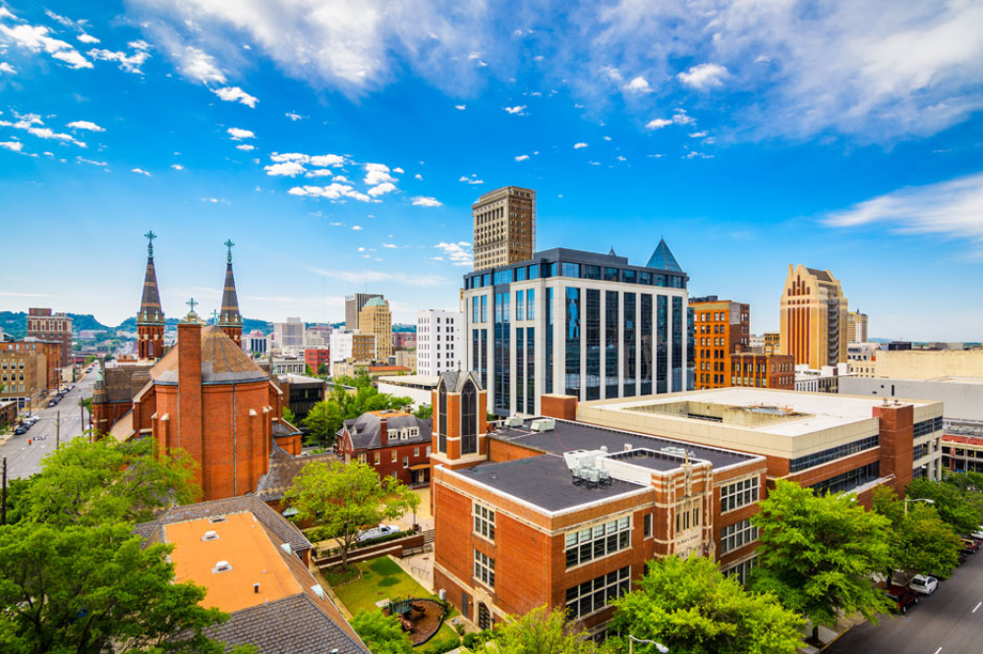
Southeast Regional Conference
April 25-27, 2018
Mountain Brook, Alabama
LEADING COURAGEOUSLY IN CHALLENGING TIMES
Notes:
SCHEDULE INCLUDES:
ICMA UNIVERSITY WORKSHOP WITH MARC OTT; ICMA EXECUTIVE DIRECTOR – LEADING COURAGEOUSLY IN CHALLENGING TIMES
AN OPPORTUNITY FOR STATE ASSOCIATION LEADERS TO MEET ONE ON ONE WITH ICMA LEADERSHIP
REGIONAL NOMINATING COMMITTEE MEETING AND REGIONAL VICE PRESIDENT CANDIDATE INTERVIEWS
ADDITIONAL EDUCATIONAL SESSIONS

Slide 5
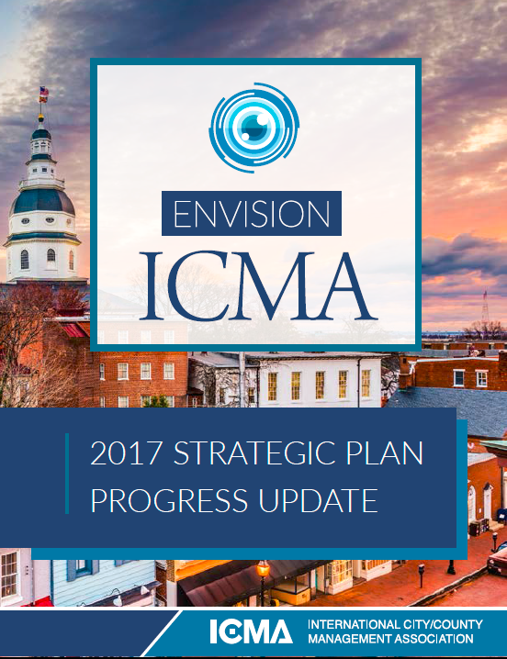

STRATEGIC PLAN
Notes:
BOARD ACCEPTED AND APPROVED PLAN IN SEPTEMBER 2016
WORK PLAN APPROVED FEBRUARY 2017
UPDATE ON PROGRESS DELIVERED AT ICMA ANNUAL CONFERENCE IN SAN ANTONIO IN OCTOBER 2017
MISSION:
TO ADVANCE PROFESSIONAL LOCAL GOVERNMENT THROUGH LEADERSHIP, MANAGEMENT, INNOVATION, AND ETHICS
VISION:
TO BE THE LEADING ASSOCIATON OF LOCLA GOVERNMENT PROFESSIONALS DEDICATED TOCRATING AND SUSTAINING THRIVING COMMUNITIE THROUGHOUT THE WORLS
KEY PRIORITIES IN THE STRATEGIC PLAN
MEMBER BENEFITS & GROWTH
LEARNING COMMUNITY
THOUGHT LEADERSHIP & RESOURCE NETWORK
ADVOCACY & OUTREACH
GOVERNANCE & OPERATIONS

Slide 6
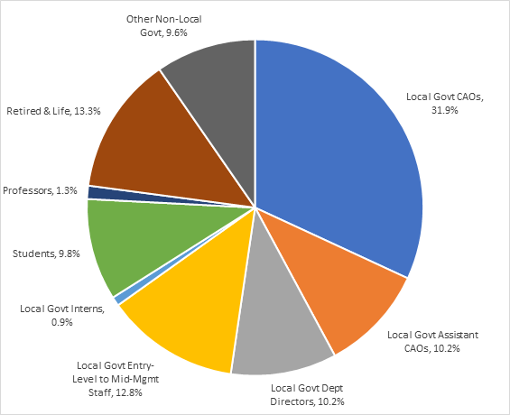
Who Are Our Members?
MORE THAN 11,000 ICMA MEMBERS REPRESENTING ALL 50 STATES AND 33 COUNTRIES!
Notes:
ICMA’S STRATEGIC PLAN: ENVISION ICMA EMPHASIZES OUR PRIORITY TO ATTRACT A BROAD AND INCLUSIVE MEMBERSHIP
ONE OF THE SEVEN CORE BELIEFS:
EQUITY AND INCLUSION: ENSURING THAT LOCAL GOVERNMENTS ARE INCLUSIVE AND MIRROR THE DIVERSITY IN COMMUNITIES
BUILDING MEMBERSHIP TOGETHER
CO-RECRUITMENT EFFORTS WITH STATE ASSOCIATIONS
FLAT RATE DUES FOR DEPARTMENT DIRECTORS
IN ADDITION TO COLLABORATION ON STATE-BASED RECRUITMENT CAMPAIGNS, THE $200 FLAT DUES RATE FOR DEPARTMENT DIRECTORS HAS YIELDED RETURNS
OVER 300 DEPARTMENT HEADS HAVE JOINED ICMA.
OVER 30% GROWTH IN EARLY- TO MID-CAREER MEMBERS
MORE THAN 11,000 ICMA MEMBERS REPRESENTING ALL 50 STATES AND 33 COUNTRIES!

Slide 7



Building for the Future
88 student chapters = 1,370+ student members
30 chapters in the Southeast region; 3 in Alabama
Does your alma mater have an ICMA Student Chapter?
Notes:
CONTINUED GROWTH OF ICMA STUDENT CHAPTERS:
THERE IS NO COST TO BELONG TO A STUDENT CHAPTER
ICMA CONTINUES TO OFFER THE ACADEMIC CO-ORDINATOR COMPLIMENTARY MEMBERSHIP IN ICMA.
WE ENCOURAGE YOU TO PROMOTE THIS WITH YOUR MEMBERS AND TO SUPPORT STUDENTS IN YOUR STATE.
WE HAVE A TARGET LIST OF OVER 90 MPA PROGRAMS THAT WE WILL BE CONTACTING THIS YEAR TO ENCOURAGE THE DEVELOPMENT OF A CHAPTER.
WE WILL BE REACHING OUT TO OUR MEMBERS WHO ARE GRADUATES OF THE SCHOOLS TO ENCOURAGE THEIR PARTICIPATION.
VISIT ICMA.ORG UNDER CAREER RESOURCES TO SEE A COMPLETE LIST OF THE CURRENT STUDENT CHAPTERS.

Slide 8
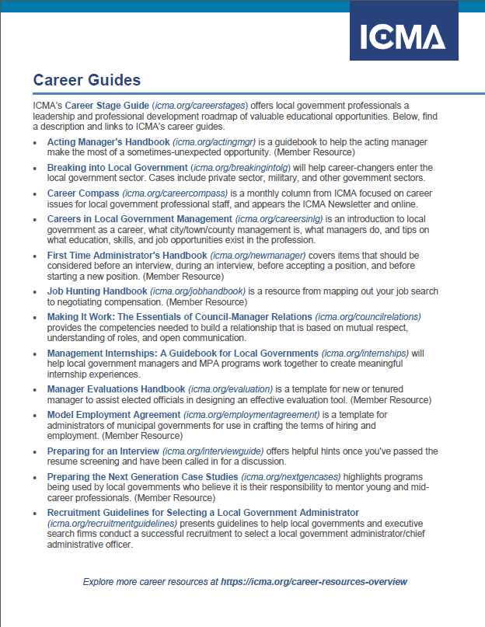
Member Benefits
Ethics Advice
Job Board
Career Guides
Networking and Knowledge Sharing
Personal Support
Professional Development
Notes:
FRAMEWORK FOR PROFESSIONAL CONDUCT WITH THE CODE OF ETHICS
EXTENSIVE INFORMATION SHARING VIA ONLINE PUBLICATIONS, BLOGS, DISCUSSION GROUPS
PERSONAL SUPPORT FOR MEMBERS IN TRANSITION, FIRST TIME ADMINISTRATORS, AND SENIOR ADVISOR PROGRAMS
CAREER NETWORK: JOB BOARD, CAREER ADVICE, COACHING
PROFESSIONAL DEVELOPMENT: ICMA UNIVERSITY; ANNUAL CONFERENCE; REGIONAL SUMMITS; WEBINARS
PROFESSIONAL RECOGNITION: CREDENTIALING; ANNUAL AWARDS PROGRAM
NOTE:
CALL FOR ICMA MEMBER COMMITTEE VOLUNTEERS WILL BE ISSUED IN MARCH; WATCH FOR ANNOUNCEMENT IN ICMA NEWSLETTER / LEADERSHIP MATTERS

Slide 9

LEARNING COMMUNITY
Live webinar subscription program
New professional development catalog with updated career stage checklist
      Students
      Early Career Professionals
      Mid-career Managers
      Executives
      Encore Professionals
Notes:
NEEDS VARY AT EVERY STAGE OF YOUR CAREER
ICMA TAILORS PROFESSIONAL DEVELOPMENT SUPPORT YOU WHERE YOU ARE ON THAT PATH:
STUDENTS: Engagement with ICMA Student Chapters
EARLY CAREER PROFESSIONALS: Leadership ICMA; Ethics 101 e-Course; LG 101 Online Certificate
MID CAREER MANAGERS: Mid-Career Managers Institute
EXECUTIVES: Senior Manager Leadership Institutes
ENCORE PROFESSIONALS: Networking opportunities and resources
ICMA has an annual subscription program for live webinars:
ANNUAL SUBSCRIPTION IS $595.
you’re encouraged to fill a conference room to provide your staff with continuing education at no extra charge.
WEBINARS impart practical knowledge on a variety of trending topics in areas that range from public safety to budgeting to human resources.
new professional development catalog:
the catalog and the online Career Stage Guide are located on the ICMA website under Career Development, then ICMA University.

Slide 10
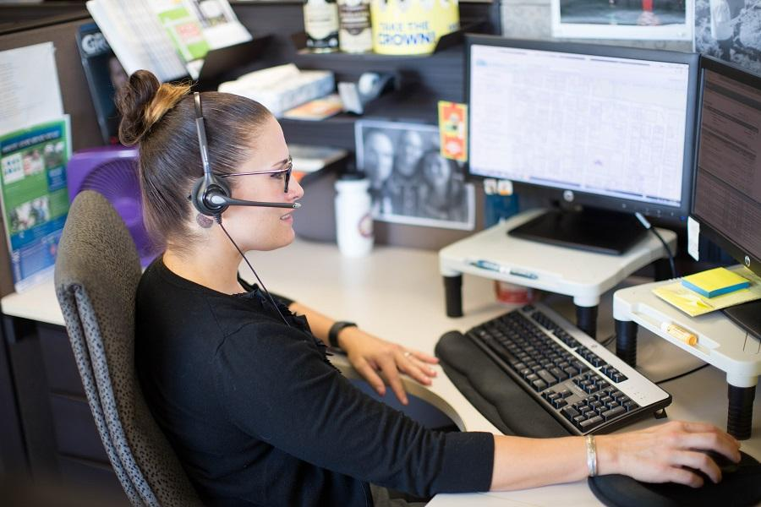
ICMA Coaching Program
6 live free webinars per year
  Effective team training
Archived webinars at
  http://icma.org/coaching
ICMA CoachConnect
  Register and get trained to Coach
  Get a coach
Notes:
2018 COACHING PROGRAM WEBINARS
MAXIMIZING YOUR GROWTH AT EACH CAREER STAGE, WEDNESDAY, FEBRUARY 28
ENTREPRENEURIAL SOLUTIONS FOR LOCAL GOVERNMENT CHALLENGES, WEDNESDAY, MARCH 28
CREATING A CULTURE FOR CULTIVATING TALENT AND GETTING RESULTS, THURSDAY, MAY 10
RECOGNIZE AND ELIMINATE BIAS: KEYS TO BEING A BETTER LEADER AND TEAM PLAYER, WEDNESDAY, SEPTEMBER 19
TAKING SMART RISKS AND REBOUNDING FROM SETBACKS, THURSDAY, OCTOBER 25
GAINING PROJECT SUPPORT FROM YOUR TEAM, ELECTED OFFICIALS, AND THE PUBLIC, WEDNESDAY, NOVEMBER 14

Slide 11

THOUGHT LEADERSHIP & RESOURCE NETWORK
Current Research & Policy Team Projects
Leadership Before, During, and After a Crisis
The Return on Investment (ROI) of Performance Measurement
The Impacts of Globalization
Recruitment / Retention: Underrepresented Minorities as City & County Managers
Notes:
FIVE CURRENT RESEARCH & POLICY TEAM PROJECTS REFLECTING EXECUTIVE BOARD PRIORITIES, JANUARY 2018
RESEARCH PROJECTS –
RESPONDING TO ICMA EXECUTIVE BOARD PRIORITIES
DELIVERABLES –
ASSESSMENTS, REPORTS, CASE STUDIES, RESEARCH PAPERS

Slide 12
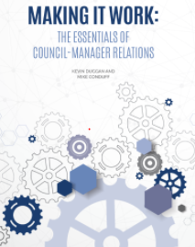
Publications, Performance Measurement
High Value e-Books --
Making It Work:
The Essentials of Council Manager Relations
Performance Measurement --
Open Access Benchmarking
New focus on Thought Leadership
Notes:
SAMPLING OF RECENT DIGITAL PUBLICATIONS:
ECONOMIC DEVELOPMENT: STRATEGIES FOR STATE AND LOCAL PRACTICE
THE MANAGER'S INSTANT GUIDE TO SUSTAINABILITY
MANAGING LOCAL GOVERNMENT: CASES IN EFFECTIVENESS
PERFORMANCE MEASUREMENT:
NEW APPROACH TO LOCAL GOVERNMENT PERFORMANCE BENCHMARKING
SIMPLIFIED PROCESS; ZEROING IN ON KEY INDICATORS AND LIMITING THE NEED FOR CONTROL BY ANY SINGLE ORGANIZATION.
THIS APPROACH, OPEN ACCESS BENCHMARKING, PROVIDES FLEXIBILITY SO THAT CITIES AND COUNTIES CAN REAP THE BENEFITS OF COMPARISON REGARDLESS OF THEIR OWN REPORTING CYCLES AND SOFTWARE CHOICES.

Slide 13

Leadership & Ethics
ICMA Code of Ethics: Promoting the highest standards of ethical conduct in the local government management profession
Leadership Standard: Revising ICMA Practices and identifying skills, abilities, and training for each practice at each career stage
Notes:
PROMOTING AN ETHICAL CULTURE IS A KEY LEADERSHIP RESPONSIBILITY. SINCE THE DEVELOPMENT OF THE ICMA CODE OF ETHICS IN 1924
ICMA HAS BUILT AN EXTENSIVE COLLECTION OF ADVICE ON ETHICS ISSUES, CASE STUDIES, AND MODEL LOCAL GOVERNMENT DOCUMENTS.
MULTI-YEAR EFFORT TO SET THE LEADERSHIP STANDARD FOR LOCAL GOVERNMENT MANAGEMENT. THE LEADERSHIP ADVISORY BOARD (LAB) HAS WORKED WITH SEVERAL GROUPS TO ADD LEADERSHIP DIMENSIONS TO THE ICMA PRACTICES, WHICH WILL BECOME EFFECTIVE IN NOVEMBER.
LAB IS NOW WORKING TO IDENTIFY THE SKILLS, ABILITIES, AND TRAINING NEEDED FOR EACH PRACTICE AT EACH CAREER STAGE.

Slide 14

ADVOCACY & OUTREACH
Ongoing support for Council Manager form of government adoption and retention
Notes:
C-M form of government adoption retention CAMPAIGNS WITH SUPPORT FROM THE FUTURE OF PROFESSONAL MANAGEMENT FUND AND STAFF WORK
2017 CAMPAIGNS WON (3)
Fair Oaks Ranch, TX (pop. 8,645) – CHANGED TO HOME RULE
Shoreacres, TX (pop. 1,600) – CHANGED FROM MAYOR-COUNCIL TO COUNCIL-MANAGER; 8 TO 1 MARGIN IN FAVOR OF CHANGE
Lakeland, FL (pop. 106,420) ABANDONMENT DEFEATED BY A LARGER THAN 2-TO-1 MARGIN
2017 CAMPAIGNS ON HOLD (2)
Saratoga Springs, NY (pop. 27,763) MOVE AWAY FROM COMMISSION FORM TO C-M FORM; RECOUNT REQUESTED; LOST BY 10 VOTES
Canton, SD (pop. 3,386) TO BE CONTESTED; 408 FOR AND 405 AGAINST A CHANGE TO THE CITY’S CURRENT CITY MANAGEMENT FORM OF GOVERNMENT TO COMMISSIONER-MAYOR FORM. AN ELECTION RECOUNT HAS BEEN REQUESTED.
2017 CAMPAIGN LOST (1)
West Jordan, UT (pop. 113,699) CHANGE CITY’S STRUCTURE FROM COUNCIL-MANAGER TO MAYOR-COUNCIL PASSED BY A 70 VOTE MARGIN.

Slide 15

ICMA 104th Annual Conference
September 23-26, 2018
Baltimore, Maryland
Notes:
10 TRACKS DEVELOPED BY THE 2018 CONFERENCE PLANNING COMMITTEE
CREATING COMMUNITIES THAT LAST
EQUITY AND SOCIAL INCLUSION
NOT YOUR GRANDPARENTS’ WORKFORCE
REDEFINING COMMUNITY ENGAGEMENT – FROM THE COUCH TO TOWN HALL MEETINGS
SMART COMMUNITIES: WHAT ARE THEY?
THE CHALLENGES—AND RESPONSIBILITY—OF PUTTING YOUR WELL-BEING FIRST
ASSISTANT/DEPUTY MANAGERS
COUNTY MANAGERS
SENIOR AND CREDENTIALED MANAGERS
SMALL COMMUNITY MANAGERS

